Slide 1
Temple Ready within an Hour of Collection Capture
OCR & HWR
+ (as available) auto-extraction
Collection
Capture
Search
Repository
Form
Tree
Temple
corrections
auto-extraction improvement

Slide 2
Temple Ready within an Hour of Capture 10-10-10-10-10 Guideline
(up to 10 minutes for each phase)
Preprocess
Collection
Keyword &
Semantic Search
Automatic
Form Fill
Deduplication
& Ingest
Ordinance
Request
(indexing)
OCR & HWR
+ (as available) auto-extraction
Collection
Capture
Search
Repository
Form
Records
Tree
Temple
corrections
auto-extraction improvement

Slide 3
Workflow Pipeline
PCFIT = Person, Couple, Family, Individual, TreeReady
PRF = Precision, Recall, F-score
Black Line: standard
Orange Line: tool testing
Green Line: tree-ready
1.pages
2.tools
<toolName>
PCFI: extracted
2.1.tool-ontology-extracted
2.2.ontology-extracted
2.3.extracted-text-cleaned
3.json-from-osmx
3.1.ontology-merged
3.2.value-cleaned
3.3.date-value-parsed
3.4.bad-relationships-fixed
3.5.authority-checked
PCFI: osmx & json
4.json-working
PCFIT: json
5.json-final
PCFIT: json & osmx
6.osmx-checked
6.1.ontology-merged
6.2.value-cleaned
6.3.date-value-parsed
6.4.constraint-checked
6.5.authority-checked
PCFI:
osmx & json
ground-truth
PRF-report
7.osmx-enhanced
7.1.target-ontology-generated
7.2.value-standardized
7.3.information-inferred
T: json
8.gedcomx
8.1.results-generated
8.2.FS-imports-generated
Notes:
Black Line (standard): 1 2 3 (4 5 6)* 7 8 – produce results for FS-search with or without user intervention with COMET. (If a path is for more than one line, it is black.)
Orange Line (tool testing): 1 2.PCFI 6.PCFI 4.PCFI – i.e. run tool test and observe the results in COMET and, if GT exists, in a PRF report; can also create GT while in COMET.
Green Line (tree-ready): 1 (2 3)? (4 5 6)+ 7 4 5 8.2 – i.e. with or without extraction-tool help, fill in extraction form; iterate until satisfactory; generate filled-in T form, including with standardized and inferred data; edit fields (text modification only); generate json in 8.2 as the final output. (Continuation to the tree and to temple ordinances is beyond the pipeline; it consists of duplicate check and human resolution, as needed, and auto-attach to the tree, and an offer to reserve temple ordinances); the dashed orange path is for extraction tool configuration without user intervention and for producing results for FS-search.

Slide 4
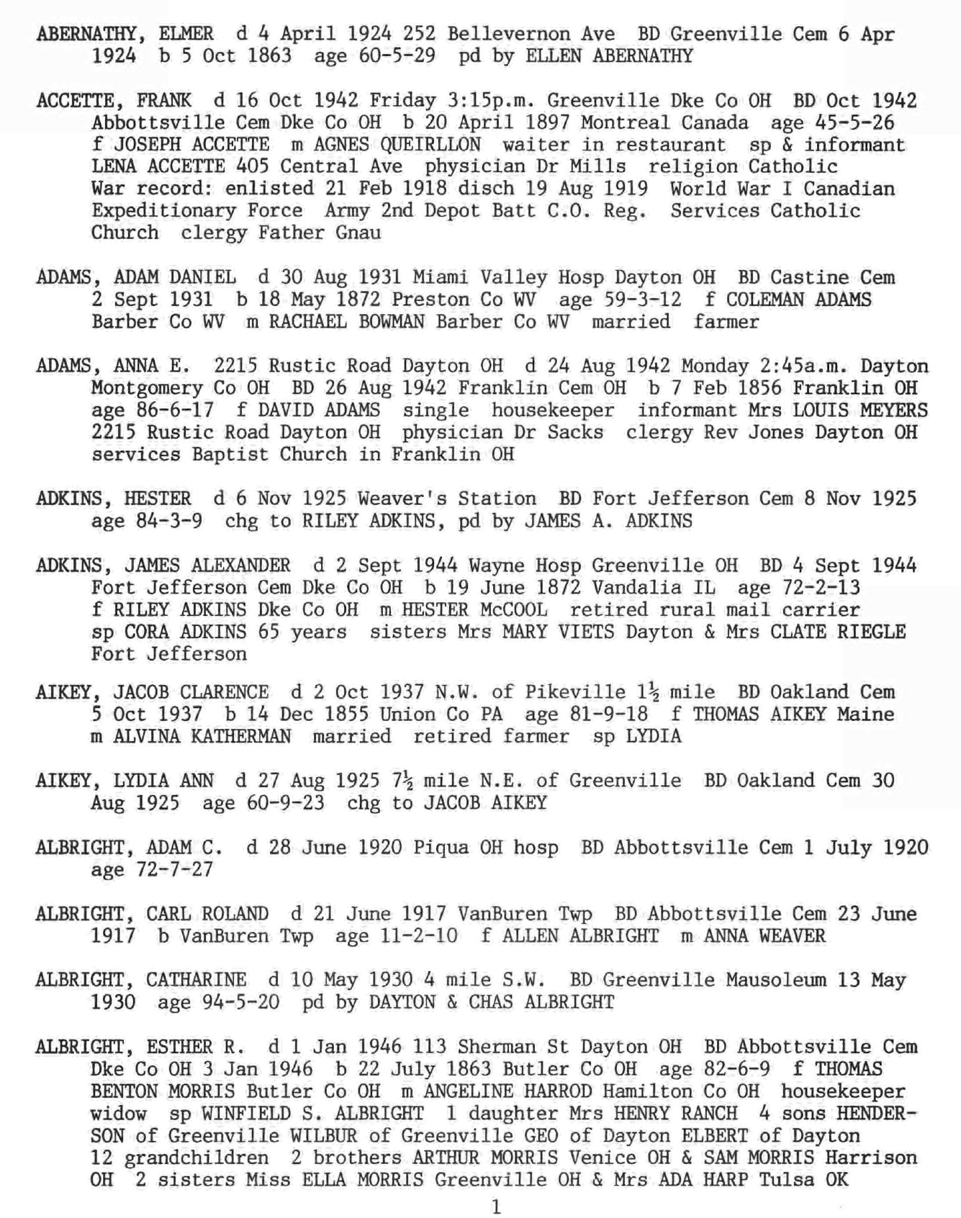
GreenQQ (Demo)

Slide 5
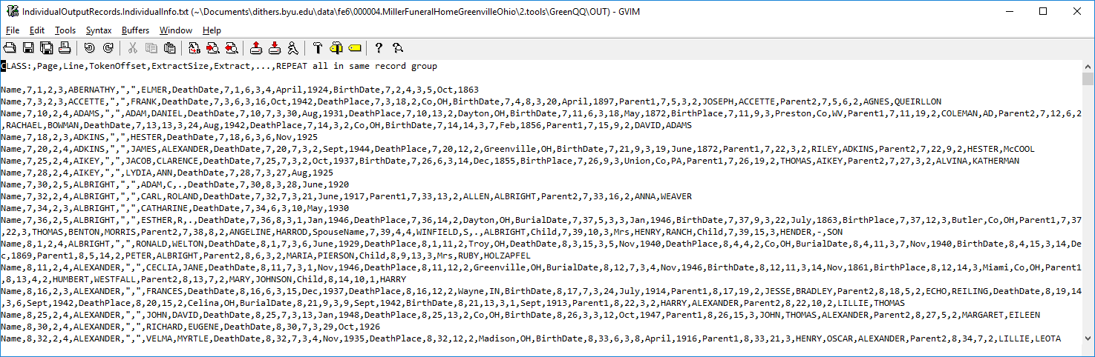
GreenQQ (Demo)

Slide 6
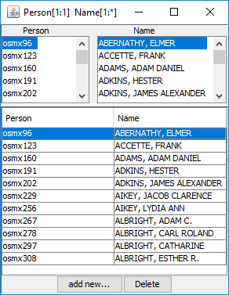
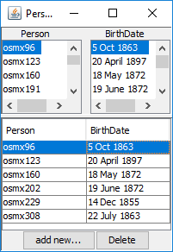
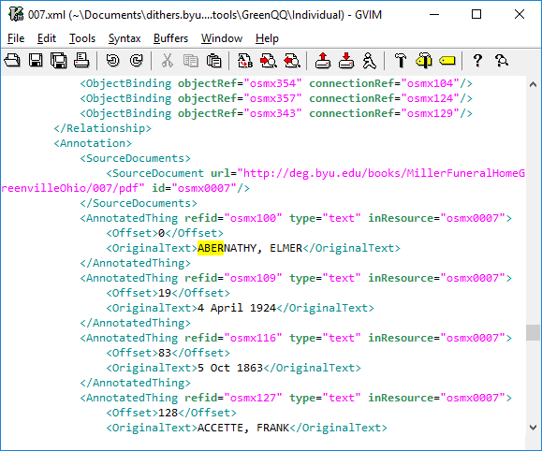
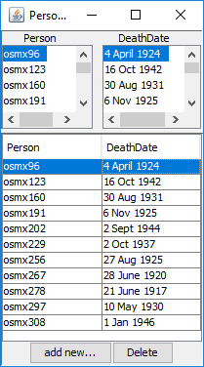
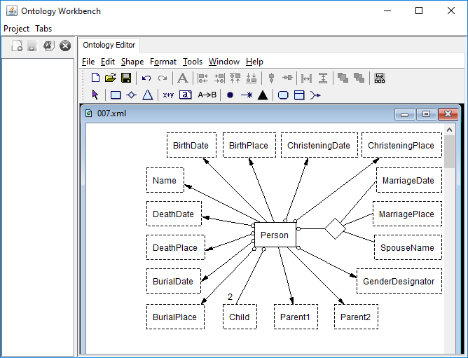
GreenQQ (Demo)

Slide 7
GreenQQ (Demo)

Slide 8
Patron Indexer User Interface (Mockup)
Rules
Parent1: <|> SOL 2433312 . William Gerard Lathrop , <|>
Parent2: <|> m . 1837 , Charlotte Brackett Jennings , <|>
Child: <|> SOL 1 . Maria Jennings , <|>
Notes:
Initial context: 3 tokens left, 1 token right. Adjust with <|>.

Slide 9
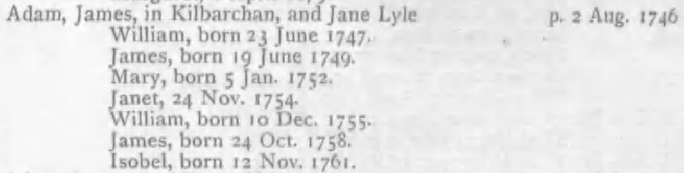
Initial Experimental Results
Notes:
With 14 rules, GreenQQ extracted ~45,000 field values (~29,000 unique) and organized them into ~19,000 records with a “hard” accuracy of 85% (“hard” meaning that every record was perfect) and a “soft” accuracy of 95% (“soft” meaning that all field values of all records are correct, although some field values present on the page may not have been extracted). Since it takes a couple of minutes to specify an example-based rule with the current GreenQQ interface, it took about 30 minutes of work to extract ~19,000 records, ~650/minute. (With the new interface, we would expect around 2,000/minute.)
Note: Kilbarchan is nicely structured, the author is consistent, and the OCR is good. A degradation of any of these factors will negatively impact results.

Slide 10
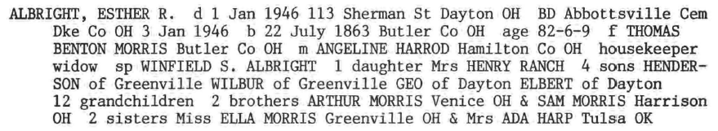
Initial Experimental Results
Notes:
As Table 2 shows, GreenQQ extracted 68,596 field values and organized them into 15,265 records.
Text snippet patterns designating field values vary much more in Miller than in Kilbarchan. “Soft” and “Hard” recall scores, respectively 0.79 and 0.73, indicate that more text patterns are needed to cover the variability, especially for burial dates and birth places. GreenQQ can help users find these patterns. Record formation has a respectable F-score of 0.97. Record formation depends on being able to accurately identify field values for the grouping field. For Miller records, “Name” is the grouping field, and the “Soft” and “Hard” F-scores are 1.00 and 0.97 respectively. These high F-scores mean that almost all field values are properly grouped into records. Indeed, in the experimental run, only one record contained an extraneous field value.

Slide 11
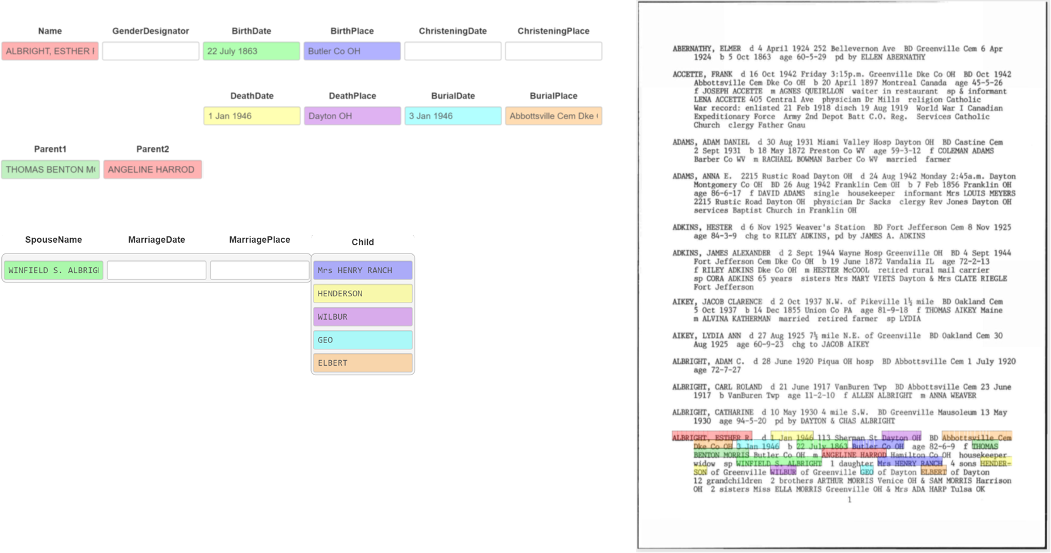
Temple-Ready User Interface (Mockup)

Slide 12
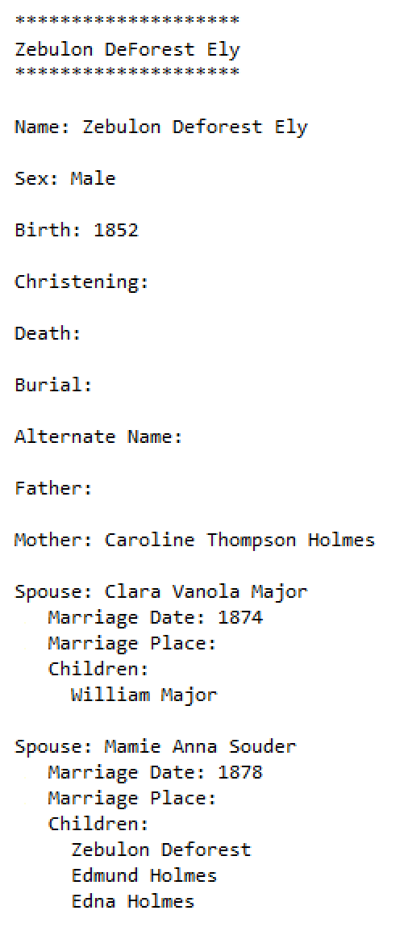
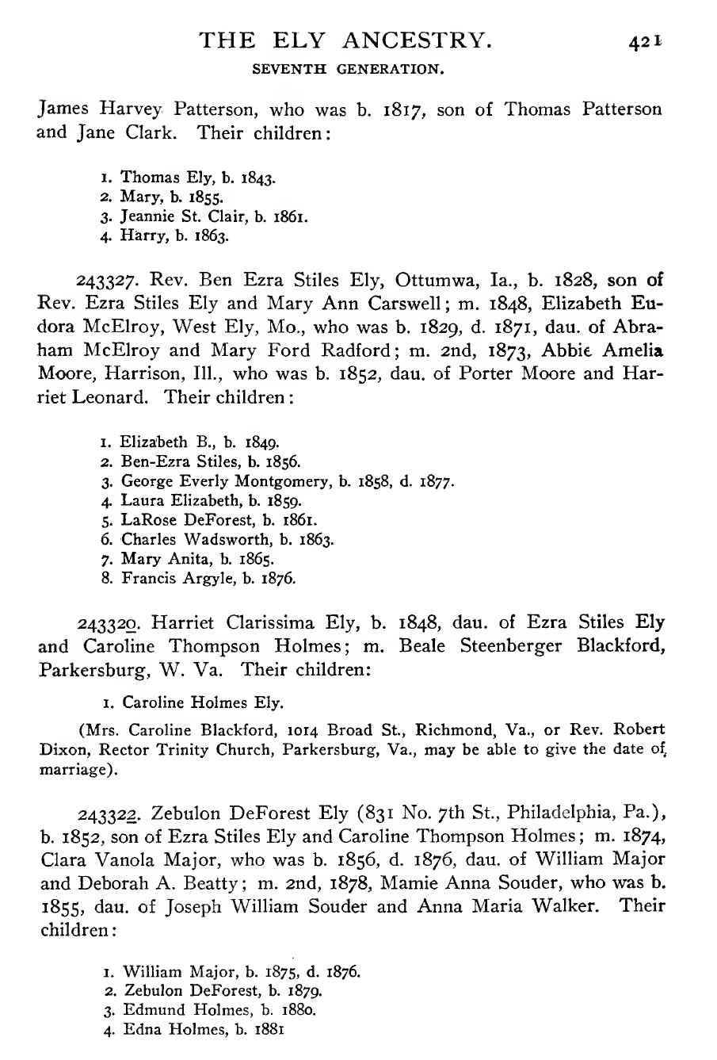
Submission Temple-Ready User Interface (Mockup)
Ezra Stiles Ely
Notes:
The form can be COMET, but the only edits that can be made are to the text fields by typing.

Slide 13
Preliminary Results
Person_Name: 4316
Person_MarriageDate_MarriagePlace_Spouse: 17
Person_Child: 2838

Slide 14
Preliminary Results
Person_Name: 1418
Person_BirthDate: 50
Person_BirthPlace: 56
Person_DeathDate: 988
Person_DeathPlace: 22
Person_BurialDate: 1
Person_BurialPlace: 8
Person_Child: 393

Slide 15
Requirements for Realization
Research
HWR (and OCR) for languages of interest
Auto-extraction (Machine Learning, Pattern Recognition, Natural Language Processing)
Bootstrapping/Improving auto-extraction from information gleaned only from Temple-Ready pipeline
ML: learning from minimal and potentially imperfect training data, active learning from corrections
PR: rule generation from form-filled submissions to tree, rule-set update from corrections to auto-filled forms
NLP: language learning from examples, both correct and incorrect
Proof-of-concept prototype development
Implementation
Search repository
Enable hybrid keyword & semantic search
Handle corrections
Update repository based on rerun of auto-extraction
Form fill
Create interface
Auto-fill form
Support additions and corrections
Tree import
Duplicate detection
Information import

